Slide 1
Media Effect Model: v4.1
August 2017

Slide 2
1. Historical Data Set
Pool Level Data Set
Conventional 30 YR Fixed Pools (FGLMC and FNCL) Factor data from 1994-01
We consider this to be a good representation of the Universe of Conventional Agency Mortgages
Loan Level Data Set
Conventional 30 YR Fixed Loans (FGLMC) Factor data from 2006-09. (FNCL) Factor data from 2014
Early years is only a small fraction of the actual Universe balance (Pool Data)
By 2017 loans are ~70% of the Universe Balance
Media Effect
Media Effect = Refi-Incentive > 50 bp
Refi-Incentive = Note Rate + Original PMI - Mtg Rate – Current LLPA – Current PMI
As a model simplification, the incentive calculation doesn’t consider the option to refinance into GNMA programs. Also, the refinance eligibility is not taken into account.
We combine the Loan Level and Pool Level calculation of Media Effect to get a combined picture from 1994 – 2017, and more weight is placed on the Loan Level calculation as the Loan Level data grows

Slide 3
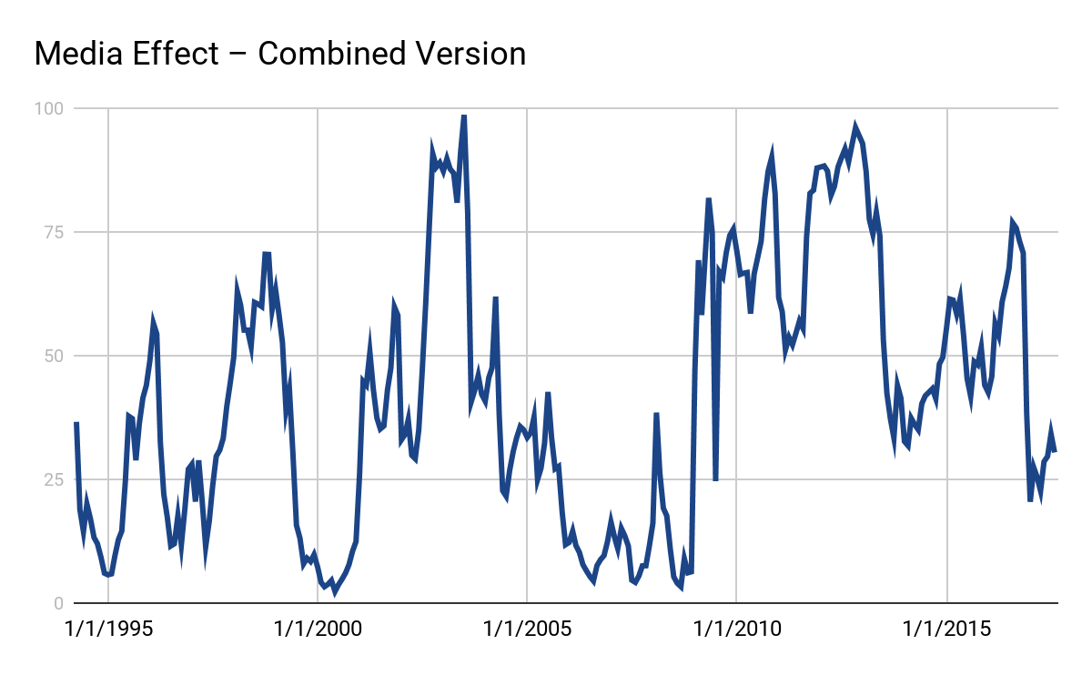
1. Historical Data Set
Media Effect – Combined Loan and Pool History

Slide 4
2. Projection Model
Universe Representation
Create a representation of the Current Universe of Conventional 30yr Fixed Mortgages
Bucket the universe by WAC buckets, range from 3.25% to 7.875% with an incremental step of 12.5 bps
Make available to Scale infrastructure via CDU files for each Factor Date
Prepayment Calculation
Calculate the SMM for each WAC bucket of the Universe forward for next period (Note that the model needs the Media Effect for the prevailing month to calculate the 1-period ahead projection which in turn determines the Media Effect for that month. In other words, there’s a bootstrapping element to the projections.)
The SMM is calculated by calling the full prepayment model (Baton_vX.XX) on each WAC bucket of the Universe
Media Effect Update
Redistributed Balances from each WAC bucket according to the SMM to the WAC bucket matching the prevailing Mortgage Rate
Calculate the Media Effect from the Redistributed Balances and the Prevailing Mortgage Rate

Slide 5
2. Projection Model
Stylized Media Effect Projection Example
$ at t=0 | %Dist | WAC Range | Bucket WAC | %CPR | Surviving $ at t=1 | Reinvestment $ at t=1 | %Dist
10 | 10% | 6.125-6.25 | 6.13% | 40% | 6.0 |  | 6%
25 | 25% | 6.00-6.125 | 5.88% | 35% | 16.3 |  | 16%
25 | 25% | 5.75-5.875 | 5.63% | 30% | 17.5 | 23.8 | 41%
30 | 30% | 5.625-5.75 | 5.38% | 10% | 27.0 |  | 27%
10 | 10% | 5.50-5.625 | 5.13% | 5% | 9.5 |  | 10%
Mtg Rate | 5.12% |  |  |  |  | 5.12%
Refi Trigger | 5.12%+50bps+LLPA+PMI-origPMI= 5.875% |  |  |  |  | 5.875%
% Refinanceable | 35% |  |  |  |  | 22%

Slide 6
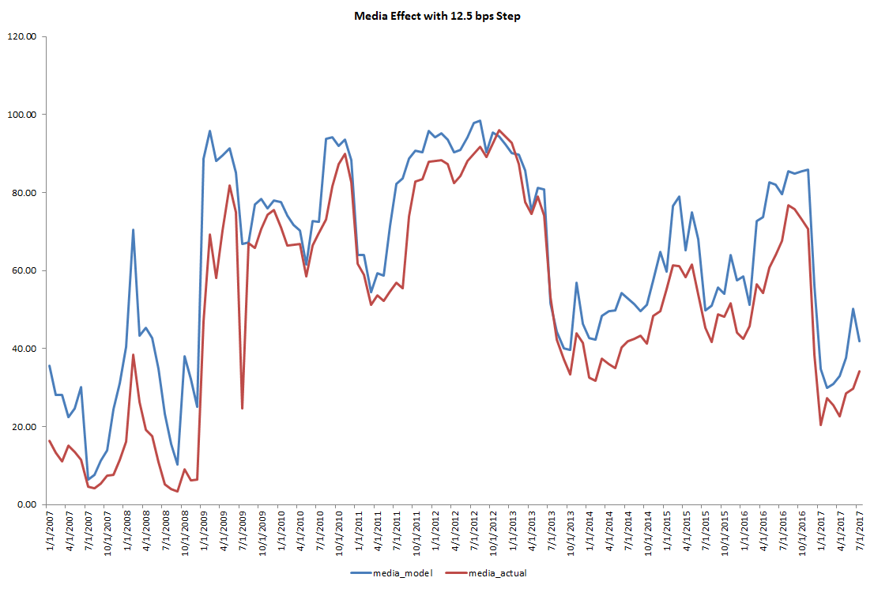
3. Potential Improvements for ME model v1.0
One step tracking for model v1.0 is consistently higher than the actual media effect. The tracking error is biased ~10% higher.
RMSE: 13.97

Slide 7
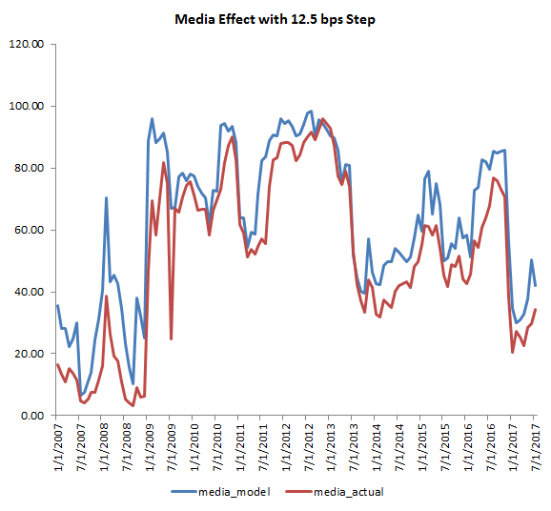
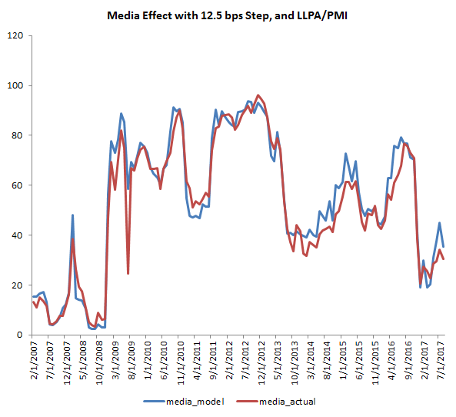
3. Potential Improvements for ME model v1.0
1) Incentive with LLPA/PMI
One reason the model values are consistently higher than actual is we are not using LLPA / PMI in our incentive calculation. The additional cost will lower the refinanceable percentage of the universe as well as the model tracking error.
RMSE: 13.97
RMSE: 6.19

Slide 8
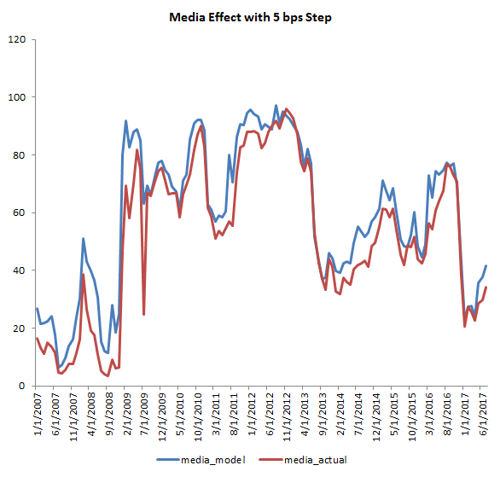
3. Potential Improvements for ME model v1.0
2) Bucket Granularity
The actual ME is generated based on loan level/pool level incentive calculation;
Model uses the universe level replines with 12.5bps steps;
Although there is no simple solution to get around the gap between the collateral level, more granularity steps will lower the tracking errors.
RMSE: 13.97
RMSE: 9.82

Slide 9
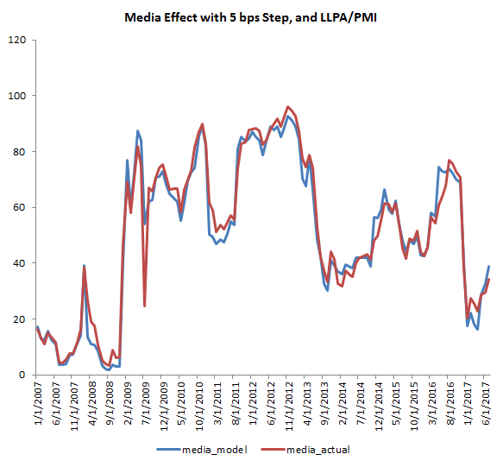
3. Potential Improvements for ME model v1.0
Combining 1) and 2), using 5bps step with LLPA and PMI in the calculation will give us a fairly accurate tracking result.
RMSE is about 25% lower in the combined version compare with using 1) only. I think the result is as expected. There will always be a tradeoff between speed and accuracy.
RMSE: 13.97
RMSE: 9.82
RMSE: 6.19
RMSE: 4.94

Slide 10
3. Potential Improvements for ME model v1.0
3) Mark to Market Adjustment
As mentioned before, the model ME is generated based on universal replines while the actual ME is from loan level incentive calculation. So there would be a dynamic dispersion spread between model and actual due to the collateral differences. A Mark to Market adjustment would be useful to minimize this dispersion.
The MTM adjustment is calculated at the beginning of projection:
Adjustment = Actual (t=0) - Model (t=0)
Model* (t=i) = Model(t=i) + Adjustment * Decay Factor(t)
If the one month adjustment is too volatile, we can seek to use a moving average of 3 months to smooth it.

Slide 11
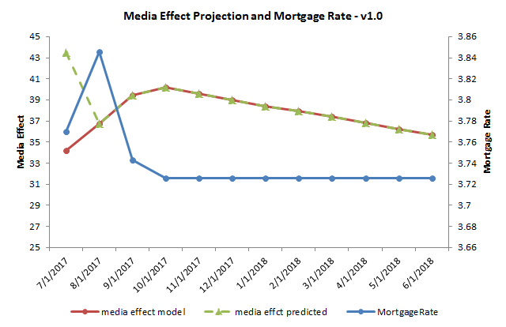
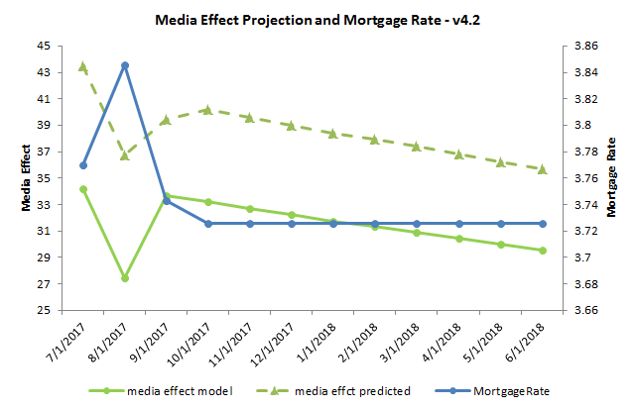
3. Potential Improvements for ME model v1.0
3) Mark to Market Adjustment
Theoretically, the media effect will be negatively correlated with mortgage rate. However, in model v1.0, the first two ME projection shows unexpected trend. The expected ME trend is because the first data point is the actual ME, while the second data point is model projection.
The way we fix the issue is to add a mark-to-market adjustment.
Instead of using the model predicted value directly from the second data point, we use the MTM adjustment to shift the prediction.
The new model shows negative correlation as expected.

Slide 12
3. Potential Improvements for ME model v1.0
4) Bug Fix for Partial Balance
When the mortgage rate falls into a bucket, our design is to count part of the balance of that bucket, assuming the balance is evenly distributed. The calculation in Scale is: media_balance_pct = ((mortgage_rate + 0.50 - wacLowerBoundary) / (wacHigherBoundary - wacLowerBoundary)) This calculation supposes to count the part of the balance between the prevailing mortgage rate and the high boundary of the bucket. But it is actually counting the part between prevailing mortgage rate and the lower boundary. The correct calculation should be: media_balance_pct = ((wacHigherBoundary - (mortgage_rate + 0.50)) / (wacHigherBoundary - wacLowerBoundary))

Slide 13
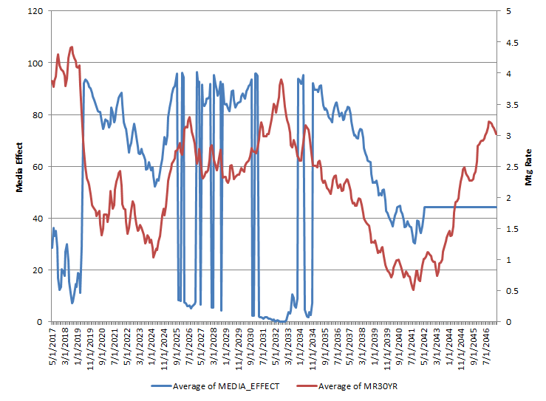
3. Potential Improvements for ME model v1.0
5) Volatile ME for Stochastic Mortgage Rate Scenario
Model v1.0 has the problem that for some stochastic rate paths, the ME projection value is very volatile. Month to month changes could be more than 80%
The issue seems to be solved by the bug fix mentioned in update 4).

